Slide 1
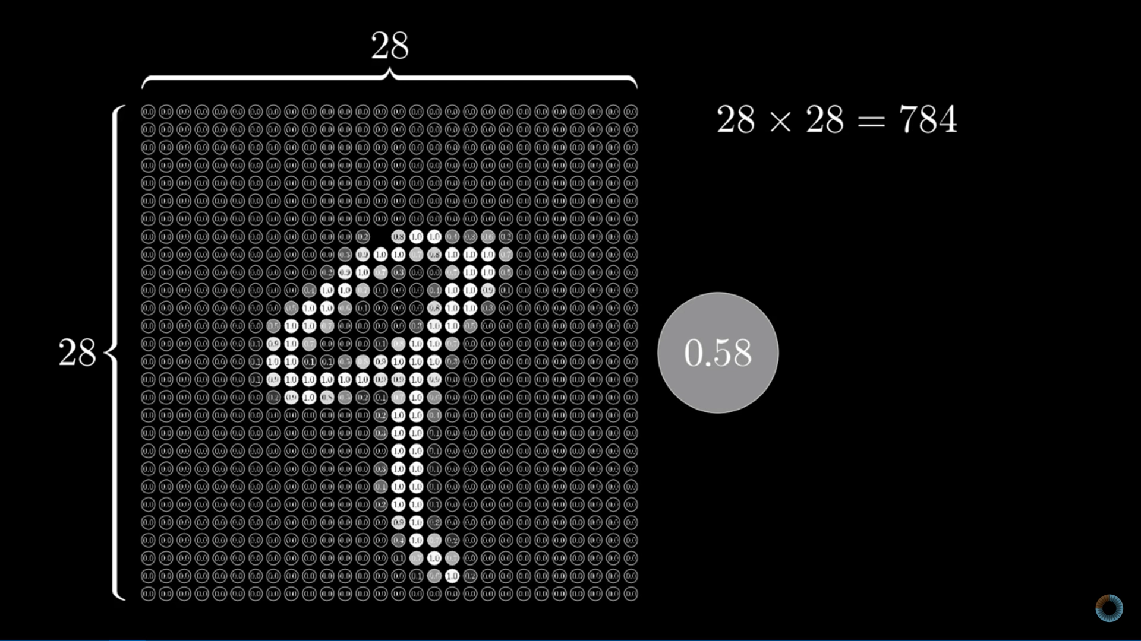
Credits : 3Blue1Brown on YouTube
A Neural Network first converts the image into what’s called a vector. This vector is fed to the model as input. Here’s the image made up of 28 X 28 values of pixels

Slide 2
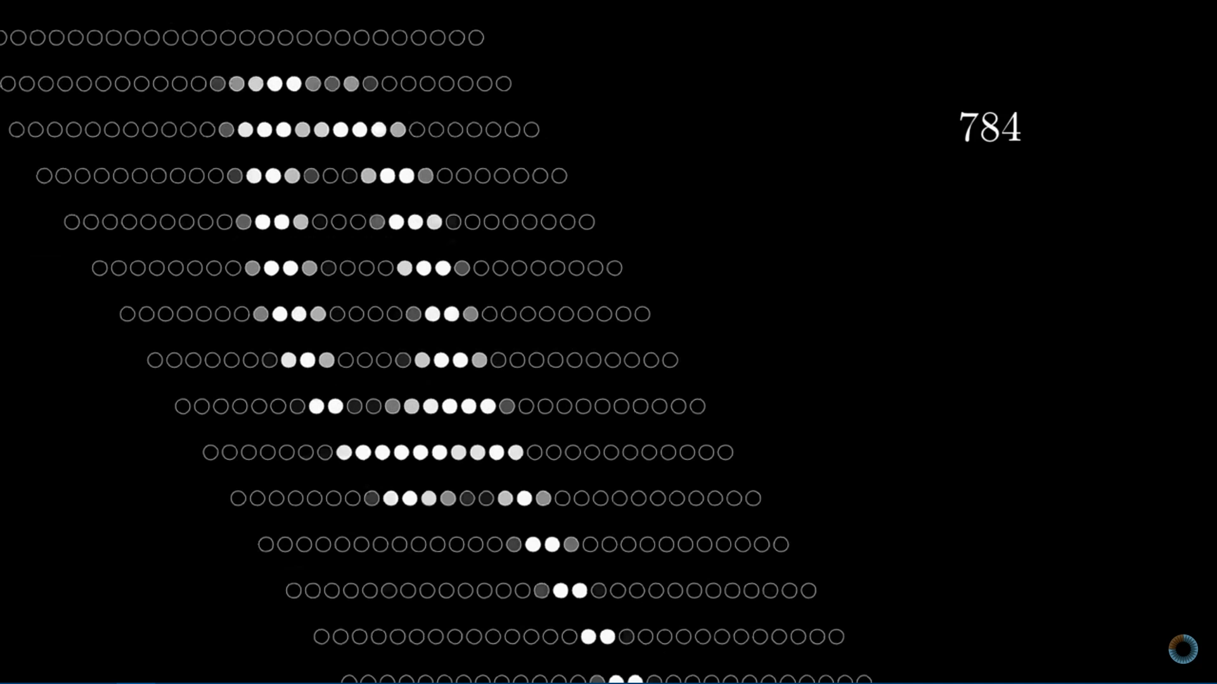
Credits : 3Blue1Brown on YouTube
Here’s how these pixel values are vectorized.

